Slide 1
V2.6.0
New Features and Process

Slide 2
Enhancements
In V2.6.0 we have added:
Downloading a copy of an item search results
Include or excluding zero quantity items while searching
Creating a similar item based on a searched item
Proper calculation for extended price on invoice

Slide 3
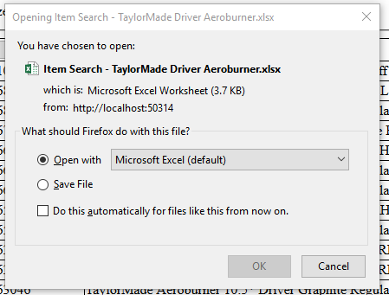
Downloading Search Results
After searching, press the Download button at the bottom of the Inventory Homepage to download an Excel file with the search results
The Excel file will be named after the search criteria

Slide 4

Including and Excluding Zero Quantity Items
While searching in the Inventory home page, the results will automatically exclude zero quantity items
By checking the box, zero quantity items will be included in your search

Slide 5
Create Similar
A user can now create a similar items to those already created.
While viewing an item there is now a create similar button.
Upon pressing a new sku will be created with all the same attributes of the item the user was viewing including quantity.

Slide 6
Proper Extended Price
The current invoices have now been improved to show the correct Extended price.
It will now include Original Price of Item, Discount Amount, Quantity Sold, Discounted Price of Item (Original Price of Item – Discount Amount), and Extended Price (Quantity Sold * Discounted Price of Item).

Slide 7
Bug Fixes
Error: When starting new sale there are items already added into cart and the user cannot cancel the sale or remove the items from cart
Currently the only fix when this happens is to shut down the browser and re-open it
We believe that we have created a work around for the error so that it can’t happen anymore
If it does please report asap
Try to remember as much information about the previous sale as possible

Slide 8
Minor Updates/Changes
Inventory paging limit increased to 50
Previously set at 25
Default inventory order set to descending order by SKU number

